Slide 1
IBM HC 2020 - Predicting the energy output of wind turbine based on weather condition
Team – Aesthetic
Saloni Shukla
Utkarsh Gupta
Jalaj Khandelwal

Slide 2
Problem Statement Power Prediction
Description –
Wind energy plays an increasing role in the supply of energy world-wide. The energy output of a wind farm is highly dependent on the wind conditions present at its site. If the output can be predicted more accurately, energy suppliers can coordinate the collaborative production of different energy sources more efficiently to avoid costly overproduction.
Expected Solutions –
Develop a time series model to Predict the power output of wind farm based on the weather condition in the site (1Hr prediction to 72Hrs. prediction) Build an application to recommend the Power Grid to suggest the best time to utilize the energy from wind farm.

Slide 3
Our approach
We split the entire process in small section so it’s easier to complete the idea.
Data Collection
Data Mining
Data Visualisation
Model Building
Understanding IBM Cloud
Designing Frontend
Deployment

Slide 4
Data Collection –
This is the first stage, where we'll gather the much-needed data, for a sufficient amount of period. Further data will be handled widely from theoretically useful parameters to least important factors values.
This process includes:
1] Analyzing the raw data
2] Understanding the raw data
Data Mining –
Data Mining is the process of playing with our previously gathered dataset. For Instance in this, we read the data, clean the data, and evaluating the data. This process is to be done under the term of data preprocessing.
Data Visualisation –
Visualization is an important part of the route to understand the fully tested model before and after optimizing it. Visualize the dataset using graphs and accessories for a deep understanding of the dataset.

Slide 5

Continuation
For this process, we'll be using a few libraries of python to our accessories.
1. Import Scikit-learn
2. Import Matplotlib
Model Building –
After compiling the trained data from the decision tree algorithm, We used Facebook prophet as our main software to analyze the time series forecasting which is a yearly basis, weekly basis, and on other various trends. It is a procedure for forecasting time series data based on an additive model where non-linear trends are fit with yearly, weekly, and daily seasonality, plus holiday effects.

Slide 6
Continuation
Understanding IBM Cloud –
This is an important milestone to be completed before moving to the frontend portion. This will give us a much clearer vision to proceed further in this project. Getting familiar with the IBM Cloud and Node-Red is a vital part of this project.
There are two major activities of this section:
1. Creating the IBM cloud account.
2. Getting familiar with node-red by creating a basic application.
Designing Frontend –
The frontend was be created with the node-red. This portion is having a time series model that is showing the predicted energy output up to several days. The dashboard is also having a predictor section where user can input the data and get the predicted value of desired date.

Slide 7
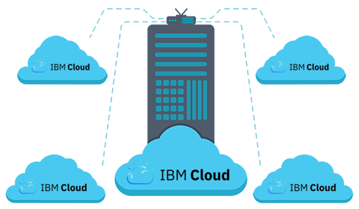
Continuation
Deployment –
We will be deploying the Machine learning code, the dataset and the our frontend on the IBM cloud platform.

Slide 8
Significance
This solution can predict the power output of a power plant, which can help the plant be more economically feasible since the over-production costs will be reduced.
Since the solution will make power generation from wind energy power plants more feasible, it can replace a significant part of other non-environment friendly ways of power production and hence making the environment significantly cleaner.
Model is scalable and can be modified easily so if we want to predict power of some other power generation source that thing can be easily employed.

Slide 9
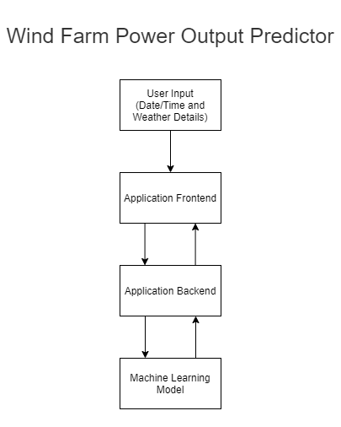
Flow Process
User will input the data in the Power Predictor column on the dashboard page which will send a HTTP request by POST method to the backend application where the input value will be injected into the model and compute the power predicted. Once the predicted power is computed by the model it will send back the HTTP response to the frontend application and power variation graphs will be generated on the visual prediction page.

Slide 10
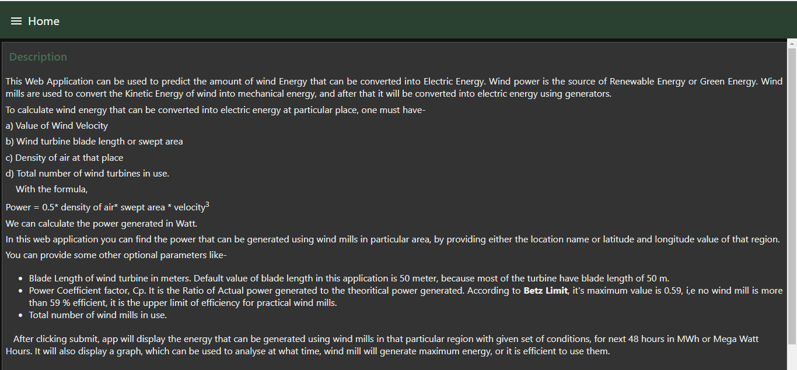
Frontend Application Home Page

Slide 11
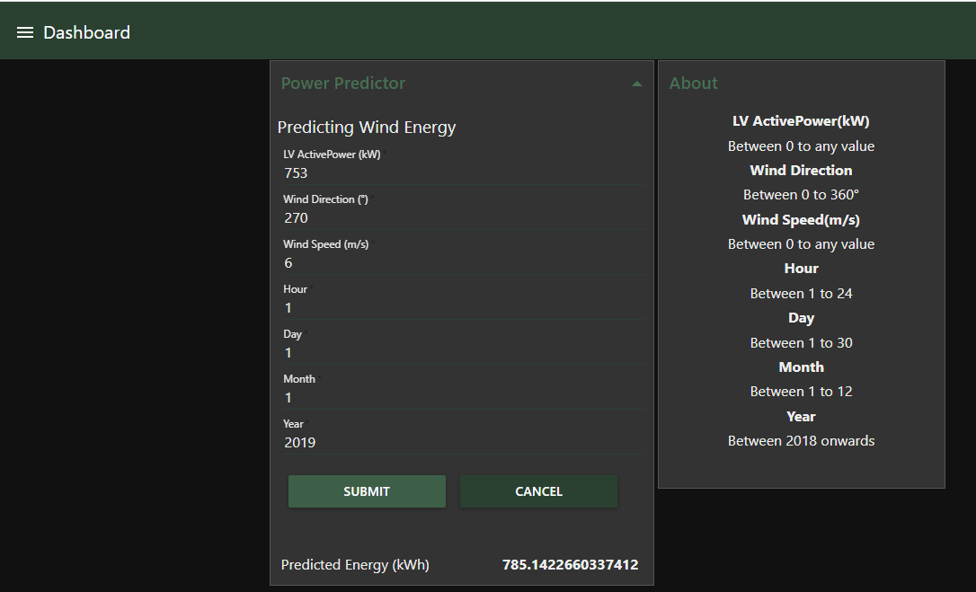
Frontend Application Dashboard

Slide 12
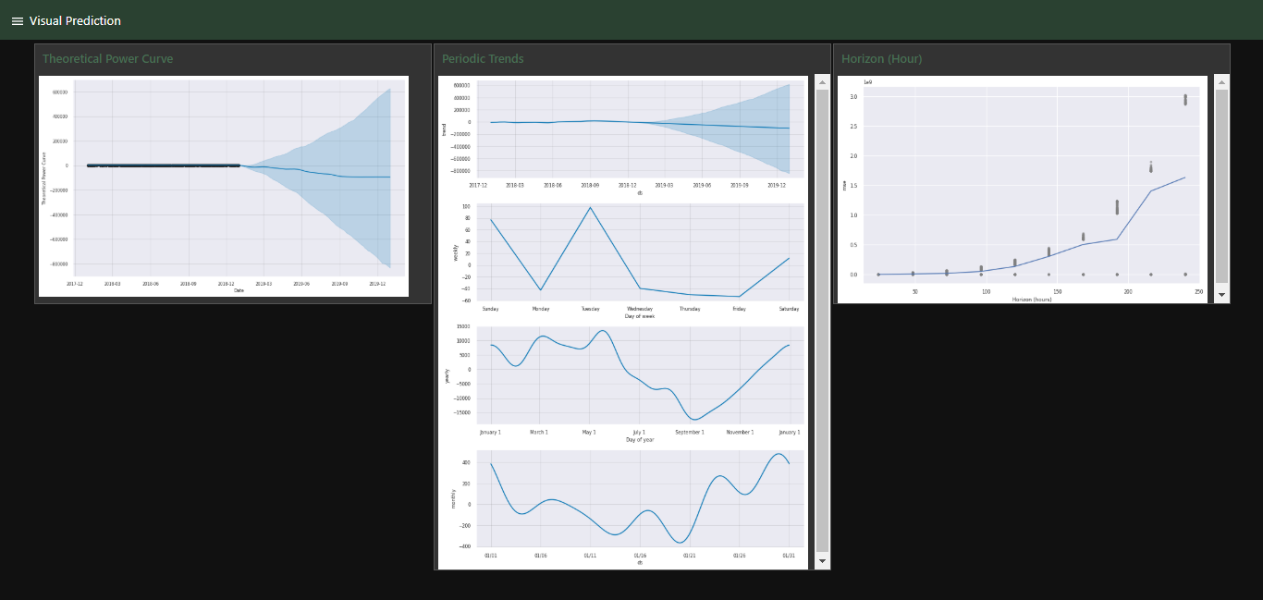
Frontend Application Visual Prediction

Slide 13
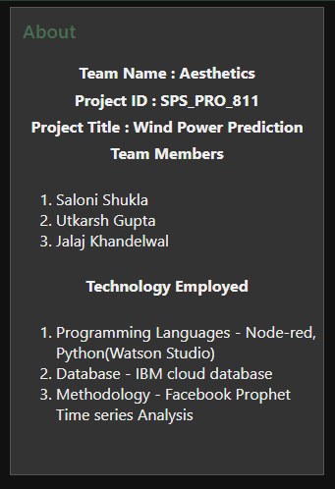
Frontend Application Team Description

Slide 14
Technology Stack
Programming Languages –
Javascript - Node-red
Python - Watson Studio
Cloud - IBM Cloud Platform
Libraries - Facebook Prophet Time series Analysis, Numpy, Panda, Matplotlib, Scikit-learn
Dataset - Wind Turbine Scada Dataset 2018 Scada Data of a Wind Turbine in Turkey

Slide 15
Thank You

